Slide 1
Converting Units Across Multiple Data Sources Using CSV Files
Mihran Simonian
12386294
Link to presentation, code, dataset and data generator:
https://github.com/mihransimonian/Uva-Block3-Big_Data-Assignment

Slide 2
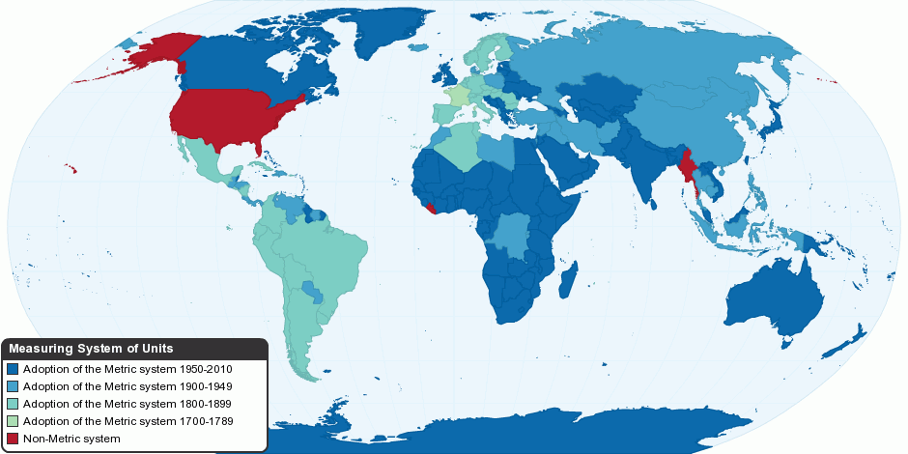
Introduction – What Are Measurement Units?
Describe a measurement: Temperature / Distance / Weight etc.
Different systems in the world, generally:
Metric system (SI)
Système international d'unites
95% of the world
US customary system: USA
Burmese system: Burma
Specific niches sometimes are applied, even today:
Imperial (UK)
Source image: http://chartsbin.com/view/d12

Slide 3
Motivation
Link to presentation, code, dataset and data generator:
https://github.com/mihransimonian/Uva-Block3-Big_Data-Assignment

Slide 4
Motivation – Why Convert Units?
Compare products
Create a (technical) design
Make decisions, e.g. procurement
Some niches require;
Oil & Gas:
Large pipes measured solely in inches US customary units, except sometimes not when European vendor
Small pipes measured sometimes in US customary and sometimes in SI metric
Engine horsepower: bhp (imperial) and hp (SI)
“British manufacturers often intermix metric horsepower and mechanical horsepower depending on the origin of the engine in question.” (source: https://en.wikipedia.org/wiki/Horsepower)
Mechanical screwthread:
English (left-hand), Metric and US Customary (right-hand)
In short; it’s quite a mess still

Slide 5
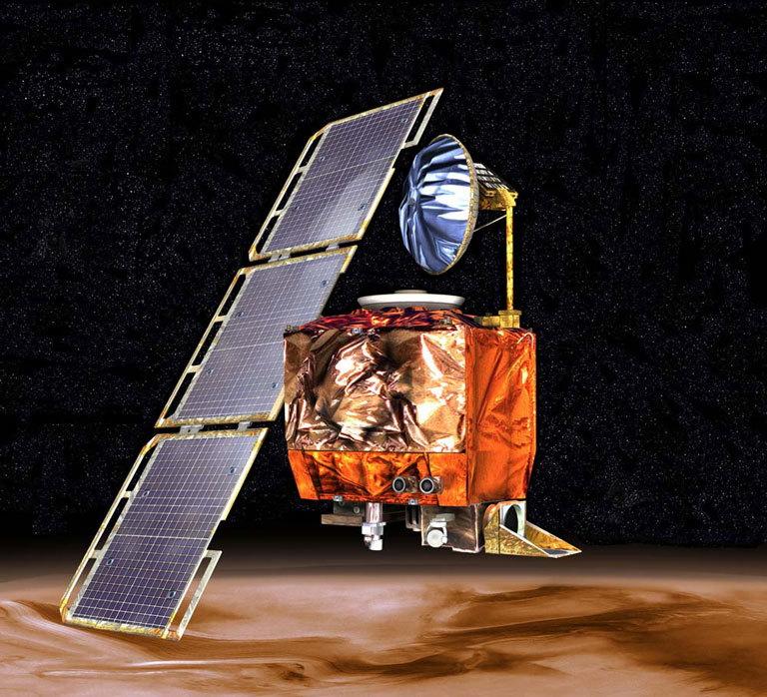
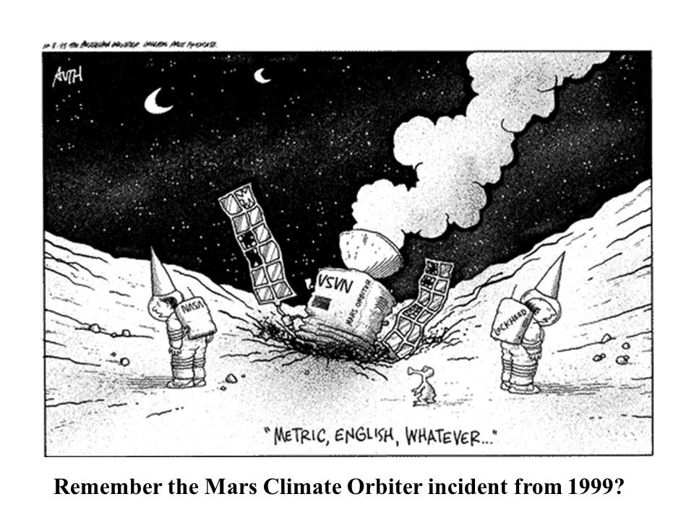
Motivation – When Things Go Wrong
NASA Mars climate orbiter, 1999
Mix-up between US Customary and SI
Orbiter crashed due to misinterpretation of units (wrong calculations)
Damage:
USD 125 million in 1999
No mars climate orbiting!
Source costs: http://edition.cnn.com/TECH/space/9909/30/mars.metric/
Source image: https://solarsystem.nasa.gov/missions/mars-climate-orbiter/in-depth/ https://images.app.goo.gl/psJdWTtZb9C1uQkd7

Slide 6
Motivation - Situational Framework
ERP system integration
Multiple vendors around the world
Use a single identifier for production identification
Have different units in place
Want a single unit representation
Each vendor should be able to design their own translation list as well for local utilization (instead of SI use US customary)
Easy adjustment and verification of unit conversion
Source image: http://chartsbin.com/view/d12

Slide 7
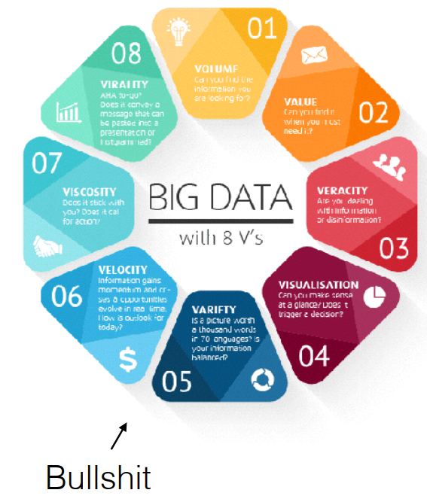
Motivation – Focus On Big Data
The famous eight V’s
Some say there are too many V’s
Focus lays on variety
Data types:
Strings
Floats
File conversion
Using files for dictionaries and databases
Touch fields of volume and speed superficially
Source image: Lecture 1, Block 3, University of Amsterdam, Big Data Class

Slide 8
Existing Methods
Link to presentation, code, dataset and data generator:
https://github.com/mihransimonian/Uva-Block3-Big_Data-Assignment

Slide 9
Existing Methods – Python Libraries
Multiple libraries exist
Either they are not sufficient, or they are too sufficient
Some abbreviations in measurement systems are used for multiple ‘subjects’, e.g. : R
Rockwell surface hardness / Radius / Rankine temperature
Some packages require the special characters: ° in temperatures, not always accepted in your csv container
Error codes frequently arose
Main issue;
it requires the coder to know what he is doing
it requires coding experience to verify/adjust the operation

Slide 10
Proposed Method
Link to presentation, code, dataset and data generator:
https://github.com/mihransimonian/Uva-Block3-Big_Data-Assignment

Slide 11
Proposed Method – Requirement: Use Multiple Files
Multiple files arrange the unit conversion
Unit conversion file - CSV
Input: database file – CSV
Output: cleaned database
Output storage:
Csv
Sql
Hdf
Parquet
Feather
This allows non-programming users to verify and adjust the unit conversion
CSV is easy to understand, works with nearly any system in the world (import/export) and is supported even by Windows Notepad

Slide 12
Implementation
Link to presentation, code, dataset and data generator:
https://github.com/mihransimonian/Uva-Block3-Big_Data-Assignment

Slide 13
Implementation – General Steps
1. Import
Database
Unit conversion list
2. Process
Convert to Pandas Dataframe
Clean each data entry (decimal points, strings, remove columns etc.)
Perform unit conversion
3. Output
Store Pandas dataframe in data container

Slide 14
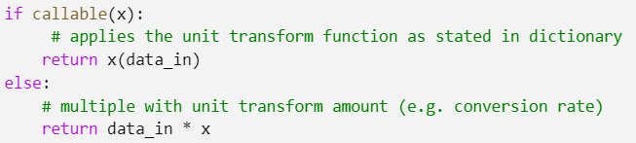
Implementation – Back to Basics: How to Convert A Unit?
1. Apply formula:
E.g. Fahrenheit to Celsius:
T_{(°C)} = (T_{(°F)} - 32) × 5/9
2. Multiply by static number
Inches to Centimeter:
D_{(cm)} = d_{(inches)} * 2.54

Slide 15


Proposed Method – CSV Unit Conversion?
Dictionary can contain both methods for unit conversion (static and formula)
A conversion number
Special case: a formula
Read a string to memory location
Update dictionary and create a pointer to the memory location

Slide 16
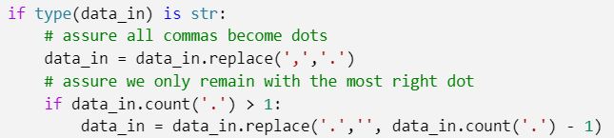
Proposed Method – Dots, Decimal Points and Thousand Separators
Countries use different systems
Choose to use decimal point
Software can create thousand separators
Excel
US: commas
Netherlands: dots
Sometimes your values are stored in strings
Try: float(number_which_is_now_in_string)
Error handling included

Slide 17
Proposed Method – Error Handling
Error handling included in functions
Main case: the variable is not the correct datatype
String is delivered expect a float
Boolean delivered expect a float
Solution:
Return string
Raise RuntimeError with datatype given and custom message (included in each function
Using Booleans to determine whether to use error handling or not

Slide 18
Proposed Method – Error Handling
Def function(input, return_error_message=False, return_runtimeerror=False):
If input is not what I expect:
Try:
Fix It if possible
Except:
if return_runtimeerror:
Raise runtimerror(error message)
If return_error_message:
Return errormessage
Return function performed on input # everything is okay and we can return the input

Slide 19
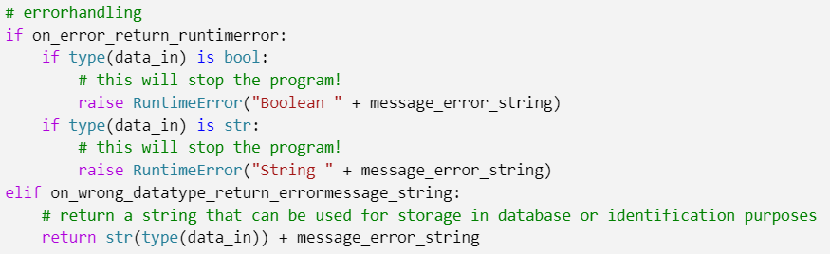
Proposed Method – Error Handling
Def function(input, return_error_message=False, return_runtimeerror=False):
If input is not what I expect:
Try:
Fix It if possible
Except:
if return_runtimeerror:
Raise runtimerror(error message)
If return_error_message:
Return errormessage
Return function performed on input # everything is okay and we can return the input

Slide 20
Proposed Method – Error Handling
Return string:
Can be stored in the database for error tracking
Return runtimeerror:
Will stop running the program, so much more useable for programmers
Runtime error has been included as it provides better tracking of error (as you can see the codelines)

Slide 21
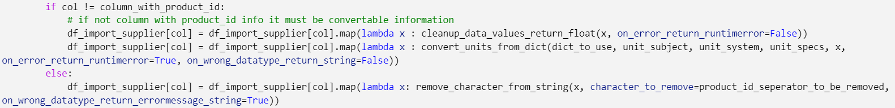
Proposed Method – Perform Conversions
Import -> Dataframe
Perform map & lambda operation on the columns in the dataframe

Slide 22
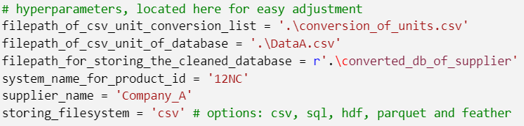
Proposed Method – Store To Container
Use built-in pandas dataframe solutions
Generally only a few hyperparameters
Easily iterateable, so we can upscale to automate our conversion method

Slide 23
Upscaling To Big Data
Link to presentation, code, dataset and data generator:
https://github.com/mihransimonian/Uva-Block3-Big_Data-Assignment

Slide 24
Upscaling To Big Data - Storage
Pandas Dataframe offers storage to popular formats:
CSV
SQL
Hdf
Parquet
Feather
CSV: ~11 MB
Parquet (compression: 5): ~3 MB
Further compression (zip, gzip etc.) possible

Slide 25
Upscaling To Big Data - Processing
Using variable translation lists and databases, only functions need to be copied to individual nodes
Relatively simple and self contained functions
Parallelization is therefore easily possible, even without the need of using advanced techniques
The whole import and transformation process can run on a single node
A network of nodes can process multiple new supplier databases
Merging to an existing database depends on the applied techniques

Slide 26
Conclusion
Link to presentation, code, dataset and data generator:
https://github.com/mihransimonian/Uva-Block3-Big_Data-Assignment

Slide 27
Conclusion – A Very Unique System
Combine loose files with specific software
By making software as generic as possible, this can be used for many instances
A relative quick system
Universally deployable
Requires little to no additional libraries (depends on storage output, code provides for installation of libraries)

Slide 28
Discussion
Link to presentation, code, dataset and data generator:
https://github.com/mihransimonian/Uva-Block3-Big_Data-Assignment

Slide 29
Discussion – Humans Remain Involved
Humans are able to adjust csv files, potentially ruining the system
We will always need a human verification
System was specifically designed to tailor the human side of the conversion; being able to use human’s capabilities in interpreting information and thus assign a new measurement unit system
Security implications as people might create functions that you don’t want to execute (formatting a drive, deleting files etc.)

Slide 30
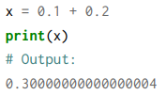
Discussion – Computer Imprecision
Computer bits allow only 1 or 0 to be stored
Numbers in essence are infinite but bits create a limitation
Due to bit size, we will always remain with an imprecision
For simple calculations not an issue
For the more advanced conversions much more important
For most cases not important
For NASA very important
With each conversion
Loose a bit of information
Create misinformation

Slide 31
End
Link to presentation, code, dataset and data generator:
https://github.com/mihransimonian/Uva-Block3-Big_Data-Assignment

